Slide 1

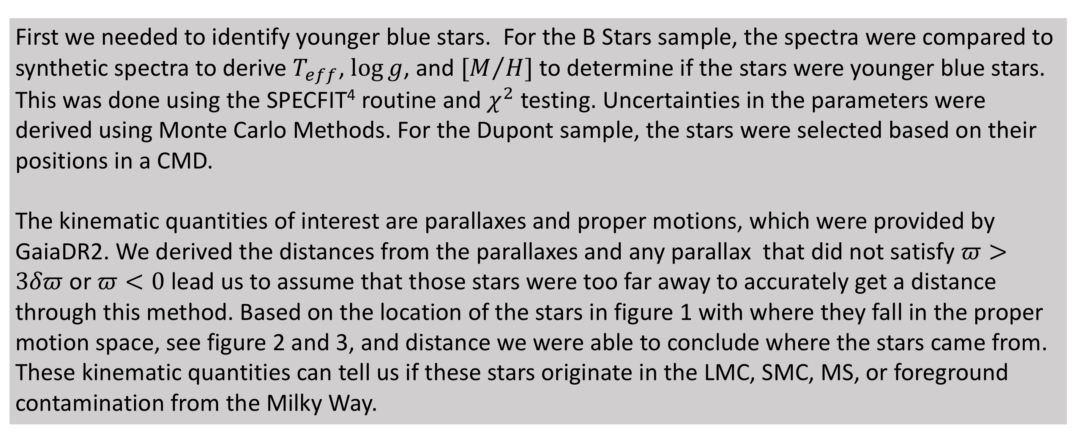
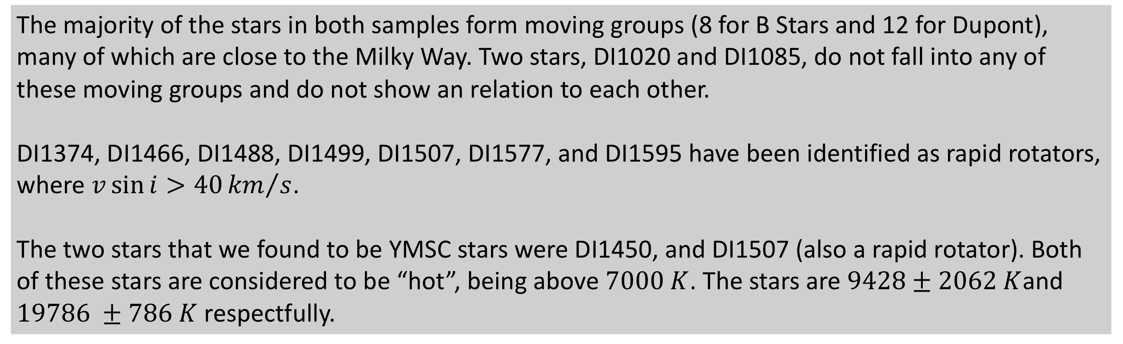
A Search For Young Stars in the Magellanic Stream
Authors: Joshua Povick¹, David Nidever¹, Jeffrey Carlin², Steve Majewski³
Institutions: ¹Montana State University, ²Large Synoptic Survey Telescope, ³University of Virginia
Introduction:
Methods:
Young stars were discovered in the Magellanic InterCloud region (ICR) in 1990 by Irwin et al.² In an effort to solve the mystery of where these stars come from, we made use of SMARTS-1.5m telescope + R-C Spectrograph (RC), 6.5m telescope + MIKE spectrograph (MIKE), and GaiaDR2¹ data. Two of these stars have been determined to be young Magellanic Stream candidates (YMSC). These stars could aid in constraining the formation of stars in lower density and metal poor regions as well as giving a more detailed composition of the Magellanic Stream.
In 2008 Nidever et al. came to the conclusion that the Magellanic Stream has at least one filament that extends out from the Southeast HI Overdensity in the Large Magellanic Cloud and must therefore traverse the ICR (2008). From this one would expect that young stars should be found in the ICR.
We make use of two datasets, B Stars and Dupont, which are two subsets of the original ICR stars. The B Stars dataset consists of 35 stars and is the initial set, while the Dupont dataset consists of 65 stars.
First we needed to identify younger blue stars. For the B Stars sample, the spectra were compared to synthetic spectra to derive $T_{eff}$, $\log{g}$, and ${[M}/H]$ to determine if the stars were younger blue stars. This was done using the SPECFIT⁴ routine and $χ^{2}$ testing. Uncertainties in the parameters were derived using Monte Carlo Methods. For the Dupont sample, the stars were selected based on their positions in a CMD.
The kinematic quantities of interest are parallaxes and proper motions, which were provided by GaiaDR2. We derived the distances from the parallaxes and any parallax that did not satisfy $π>3δπ$ or $π<0$ lead us to assume that those stars were too far away to accurately get a distance through this method. Based on the location of the stars in figure 1 with where they fall in the proper motion space, see figure 2 and 3, and distance we were able to conclude where the stars came from. These kinematic quantities can tell us if these stars originate in the LMC, SMC, MS, or foreground contamination from the Milky Way.
Results:
References:
The majority of the stars in both samples form moving groups (8 for B Stars and 12 for Dupont), many of which are close to the Milky Way. Two stars, DI1020 and DI1085, do not fall into any of these moving groups and do not show an relation to each other.
DI1374, DI1466, DI1488, DI1499, DI1507, DI1577, and DI1595 have been identified as rapid rotators, where $v\sin{i>40{km}/s}$.
The two stars that we found to be YMSC stars were DI1450, and DI1507 (also a rapid rotator). Both of these stars are considered to be “hot”, being above $7000 K$. The stars are $9428±2062 K$and $19786 ±786 K$ respectfully.
1) Gaia Collaboration, Prusti, T., et al., 2016, A&A, Volume 595, id.A1, 36 pp.
2) Irwin, M. J., Demers, S., & Kunkel, W. E. 1990, AJ, 99, 191
3) Nidever, D. L., Majewski, S. R., & Burton, W. B. 2008, ApJ, 679, 432
4) Nidever, David, https://www.noao.edu/noao/staff/dnidever/Software.html

